Slide 1
What is Hippo CMMS?
Hippo is a Work Order software system designed to help keep Maintenance tracking in order and to help those requesting maintenance in communication when work needs to be completed.
Requesters can submit information to the Maintenance Manager to be completed and can view the status of their requests using the cloud-based platform by accessing on any web browsing device.

Slide 2
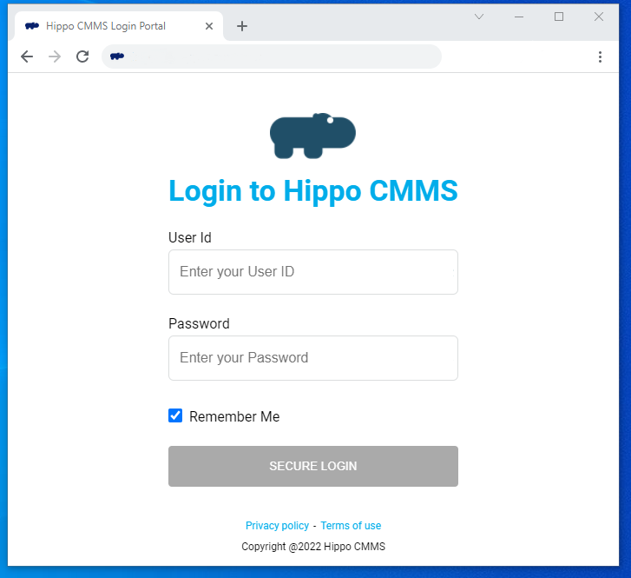
Logging in
csumb.hippocmms.com
Any web browser on computer, tablet, or phone
csumb.hippocmms.com
Log in using the UserID and password provided by Admin

Slide 3
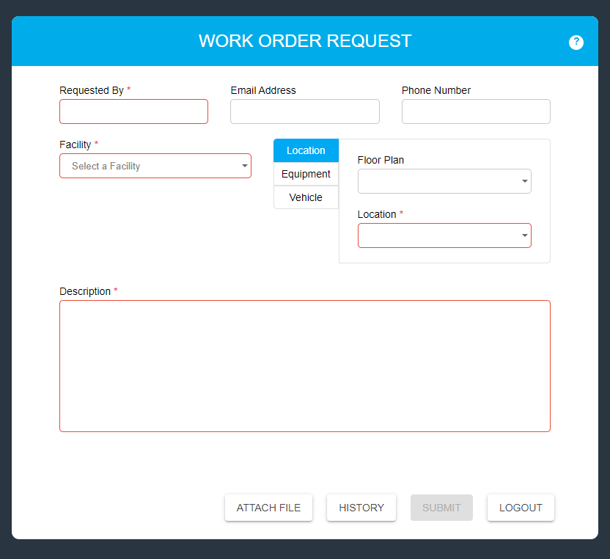
Filling out the Request Form
Start Here: Choose the Facility where you are requesting the work
Fill out all information in the boxes marked red outline / asterisk
Locations and Equipment can be filtered by Building by using the “Floor Plan” drop down menu
Enter a description of the work you would like requested with as much detail as possible for the technician
The Submit button will turn blue once all the required information is entered.
When a request is successfully submitted – a green box will appear at the bottom of the page
Files can be attached here, to provide additional information

Slide 4
Adding a file attachment
To provide further information, you may attach a file to the request form that will be visible by the maintenance technician.
Once the file is uploaded, you can choose to remove the file if it was incorrect using the trash can icon or if you choose to no longer want to add an attachment click the red delete button.

Slide 5
Work Order Request History / Status
Requesters can see the details of their work order under the “History”.
The Status will change as the technician accepts the request and the Work Order Status will change as the technician completes work.
Work Orders may be rejected if the issue has been previously reported or if the work cannot be completed at this time. The reason for the rejection will be stated from the technician.

Slide 6
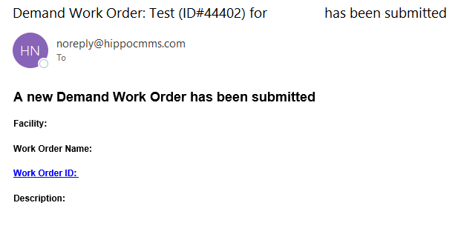
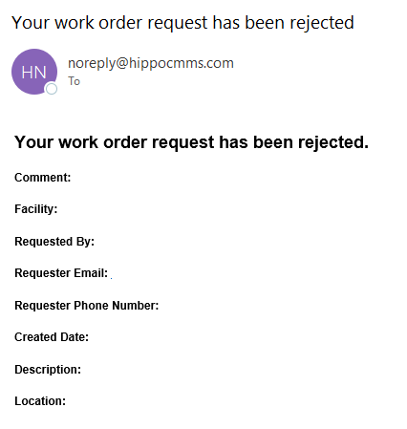
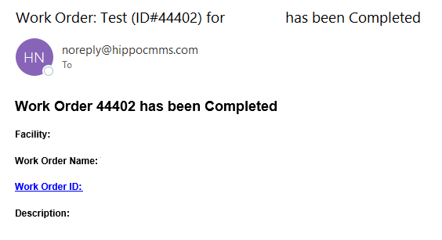
If Requesters have entered their email address, they will receive emails when the Work Order has been submitted and there will be a follow up email when the work is rejected or completed
Receiving Emails

